Slide 1



Interview Prep: Trees
Samuel Bishop

Slide 2


Experiences to think about while in College
- Research Opportunities
- Open-Source Contributions
- Personal Projects

Slide 3
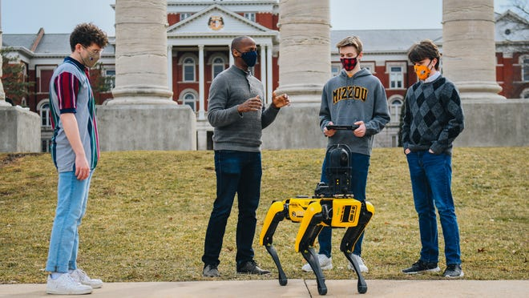
Research Opportunities
Many of the CS/IT/ECE professors have government grants to pursue something an area of research.
Can ask professors about positions available (being a good and engaged student increases your chances).
Paid sometimes (Honors Research Credit Available).

Slide 4


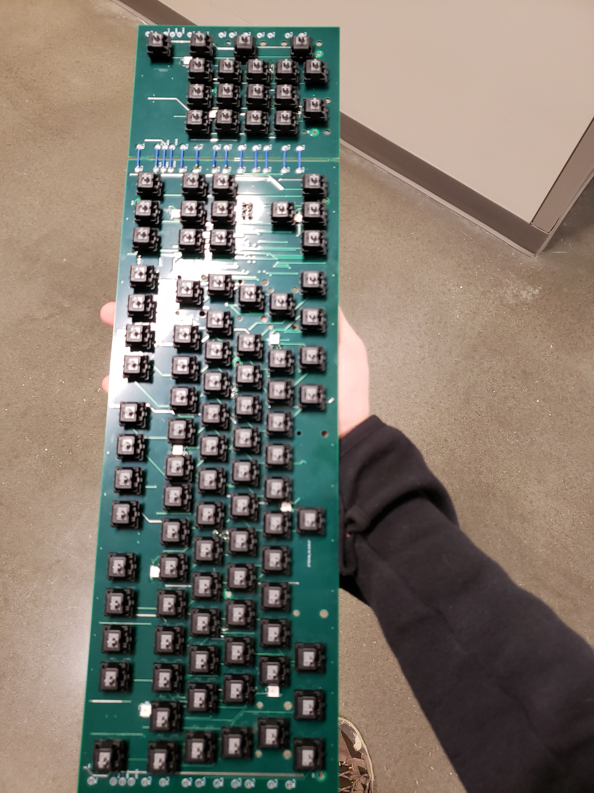

Open-Source Contributions

Slide 5
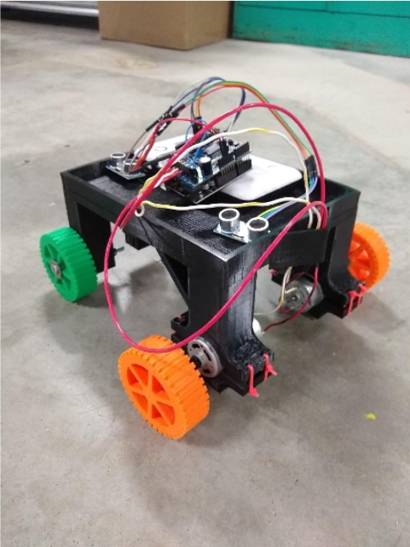
Personal Projects
This is where MCA and/or Hackathons can come in handy
Ideas
Build a website
Build an app
3D Print Something
- Not sure what to do? Try Udemy!

Slide 6
Coding Section

Slide 7
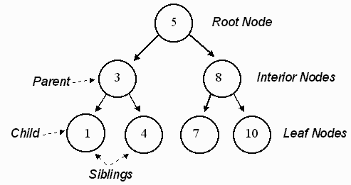
Tree (Data Structure)
Composed of Nodes
Each tree has a root node
Root node has 0 or more child nodes
Each child has 0 or more child nodes
Non-cyclic

Slide 8
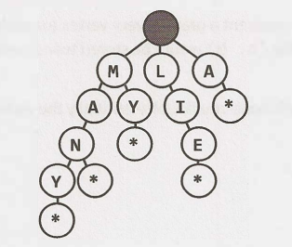
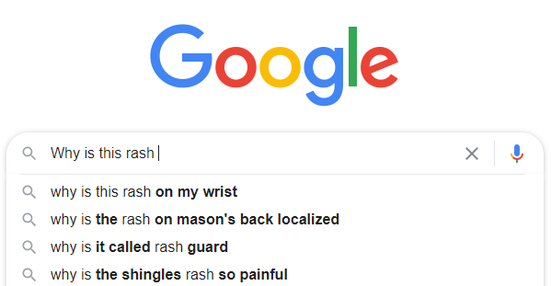
Why are Trees Important?
Massively Important when indexing content. In cases of binary trees allows for O(logN) time complexity while searching. Complexity can be dropped even lower than that if trees are non-binary.

Slide 9
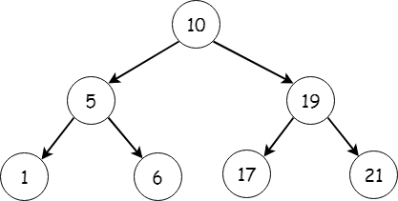
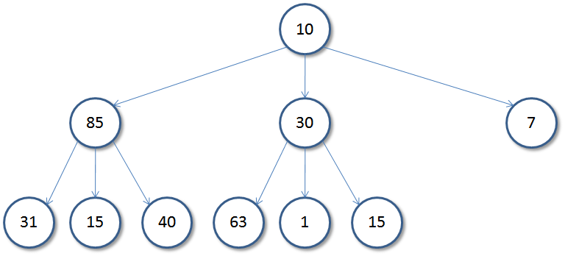
Binary Tree
Each node has up to two children.
Leaf: Nodes without children
A Binary Tree
NOT a Binary Tree

Slide 10
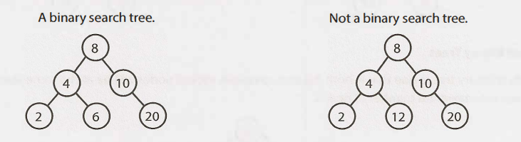
Binary Search Tree
Each node in the binary tree fits in a specific order (usually ordered Ascending -> Descending or vice versa)
Trees can be sorted on attributes that are not numbers

Slide 11
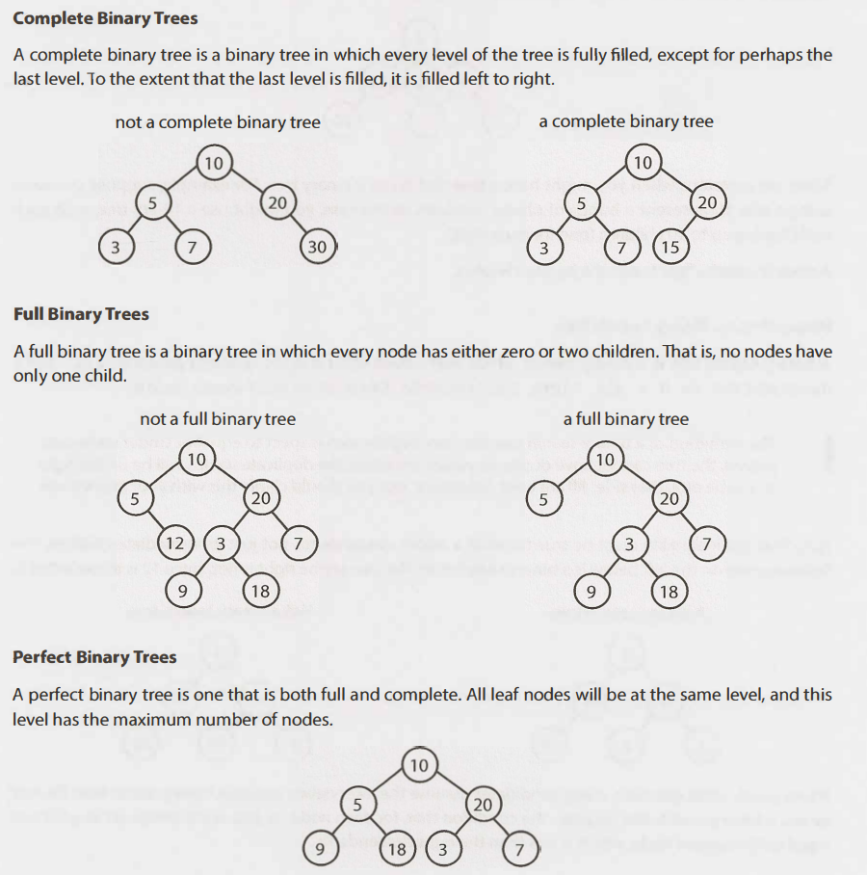
More Tree Terminology

Slide 12
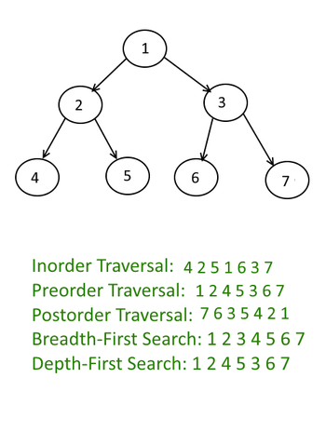
Tree Traversals
PSUEDOCODE-
In-Order:
inOrderTraversal(TreeNode node):
if (node != null):
inOrderTraversal(node.left)
visit(node)
inOrderTraversal(node.right)
preOrderTraversal(TreeNode node):
if (node != null):
visit(node)
inOrderTraversal(node.left)
inOrderTraversal(node.right)
preOrderTraversal(TreeNode node):
if (node != null):
inOrderTraversal(node.left)
inOrderTraversal(node.right)
visit(node)

Slide 13
Practice Question
Minimal Tree: Given a sorted (increasing order) array with unique integer elements, write an algorithm to create a binary search tree with minimal height.

